Slide 1

UNIMPIEGO CONFINDUSTRIA is a Confindustria company (sole shareholder) active since 2004 and authorized by the Ministry of Labor to operate in the labor market intermediation sector.
The service offered to companies is managed by a team of experts supported by a database of over 50.000 up-to-date resumes and a website.
The candidate search process involves a thorough analysis of the job description for any position and at any professional level.
UNIMPIEGO CONFINDUSTRIA has assisted over 15.000 companies in recruiting and selecting personnel.
These activities are carried out by the 32 offices affiliated with Unimpiego Confindustria, with service counters located at member industrial associations.
Each of these offices serves as a centre for data collection and service delivery, connected to the national network of which it is an integral part.

Slide 2


Slide 3




ICI - ITALY CALLS INDIA: A University-Enterprise Talents Bridge
Connecting Indian Talents with the Italian Business Ecosystem
An experimental project promoted by Confindustria, CRUI, and Uni-Italia, with the support of the Embassy of India in Italy and MAECI. Our goal is to profile and value the human capital of Indian students in Italy to facilitate their professional integration into national enterprises.

Slide 4
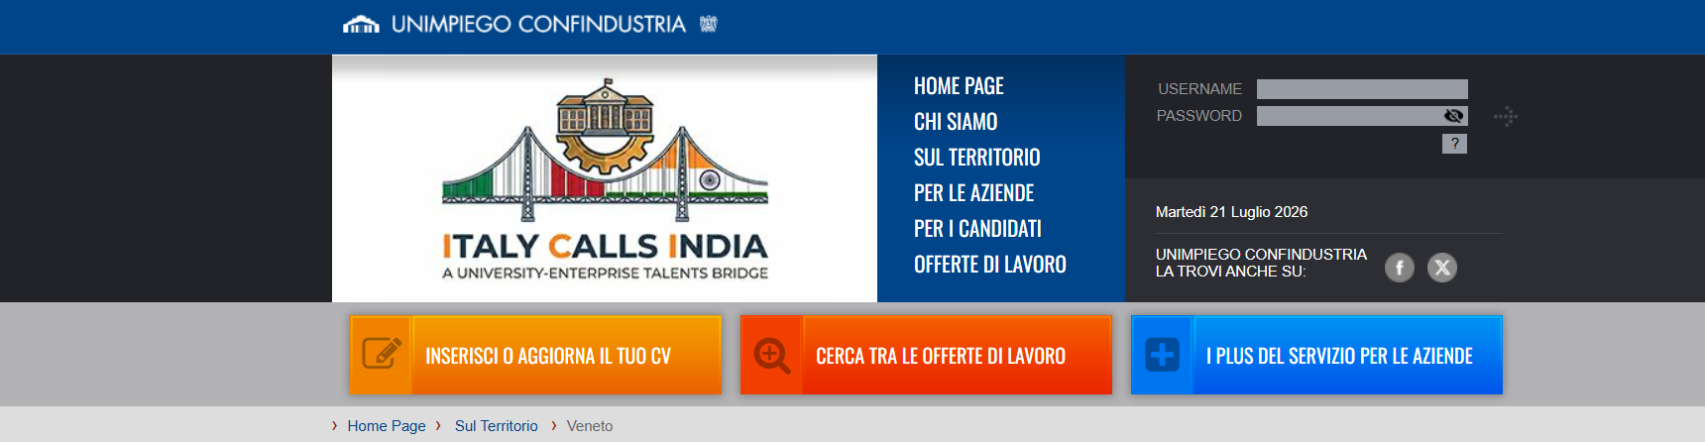
Interested students can access the site by clicking on the banner at the top for the ICI - ITALY CALLS INDIA project on the website www.unimpiego.it
or access it directly via the link https://unimpiego.it/iciindia

Slide 5
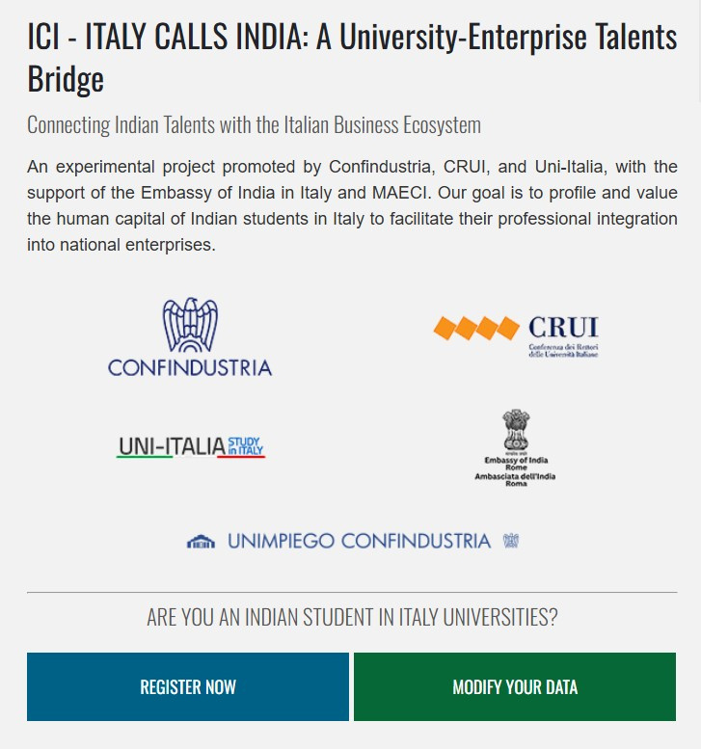
Those interested should fill out a simple form by clicking the button “REGISTER NOW”

Slide 6
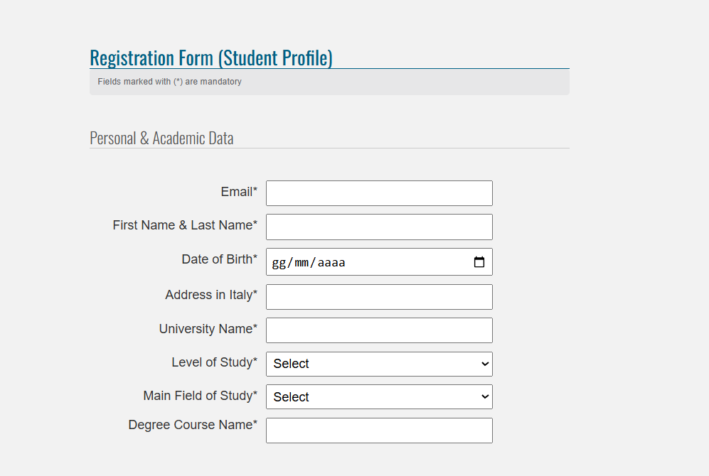

Slide 7
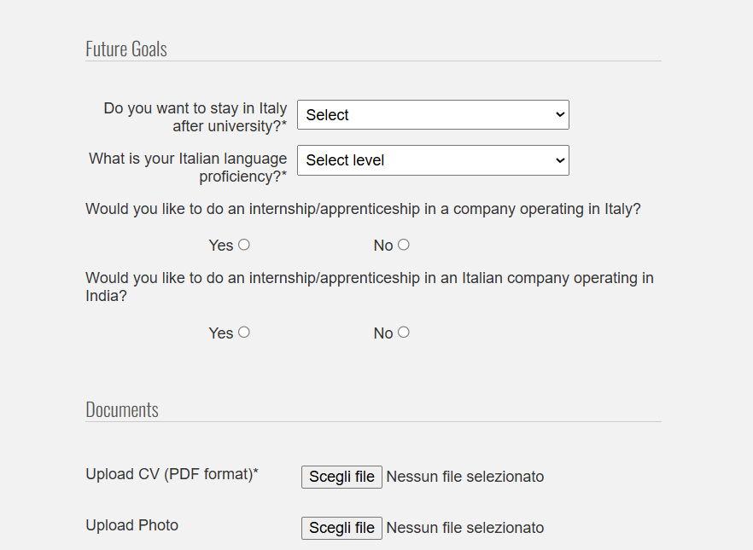
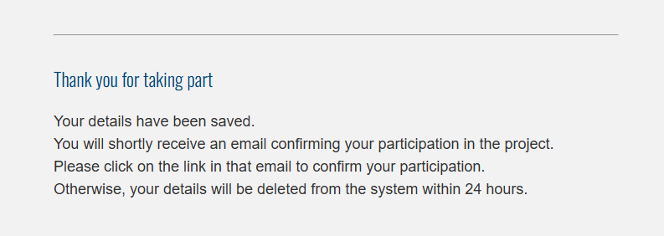
Then you need to authorize Unimipiego Confindustria for privacy and click “SEND”

Slide 8
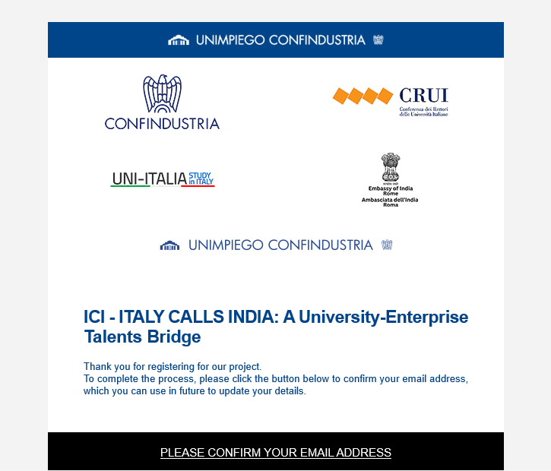
After registration, you’ll receive an e-mail for confirm your partecipation in the project and you'll need to log in to your email account to confirm that.

Slide 9
To update the form, you need to click on the “MODIFY YOUR DATA” button

Slide 10

The data on the 329 students received to date come from the following university programs:
  17 Health Care
  43 Humanities
  84 Social Sciences
  185 Stem

