Slide 1
Horizontal Call for WP 2026-2027: R&I in Support of the Clean Industrial Deal
Clean Industrial Deal: Building Bridges Across Clusters
Antonio Ferrández García
Policy Officer DG RTD – E3 Industrial Transformation
1

Slide 2
Policy Context
2

Slide 3
Policy Context – Clean Industrial Deal (CID)
CID Communication was published on 26 February 2025 - as a follow-up to the Competitiveness Compass, it aims to direct investment towards infrastructure and industry in order to support the EU’s industrial decarbonisation, growth, and competitiveness goals.
Confirms Europe’s dedication to these goals by offering clear business incentives to support the decarbonisation and competitiveness of European industry, at the same time. It will help creating lead markets to boost supply and demand in clean tech, accelerate the roll-out of clean energy & manufacturing, and reinforce a circular economy.
It focuses on energy-intensive industries and on clean tech sectors
The Communication states that “R&I is a key enabler for promoting the next generation of clean tech, clean energy and decarbonised manufacturing in the EU. The flagship Horizon Europe call of ca. EUR 600 million under the 2026-2027 work programme supports fit-for-deployment projects.”

Slide 4
Call Overview & Principal Features
4

Slide 5
CID Horizontal Call – Overview
Horizontal call (between Clusters 4 and 5), with 2 topics (in each year; 2026 & 2027):
1. Clean Technologies for Climate Action
→ EUR 290 million across 2026 and 2027
2. Decarbonisation of Energy-Intensive Industries
→ EUR 250 million across 2026 and 2027
Both topics are Innovation Actions targeting fit-for-deployment solutions
A complementary call of EUR 50 million in support of the Clean Industrial Deal is included in the Research Fund for Coal and Steel.

Slide 6
Principles & Features of the Call
Open Character
Applicants are free to decide on the specific tech value chain they wish to strengthen through innovative competitive & decarbonization solutions
Focus on Industrial Competitiveness
Demonstrate industrial leadership in view of the deployment after the project (i.e. put together a consortium composition that allows for effective collaboration between relevant stakeholders and future deployment).
Set out a sound business plan and market-readiness strategy on how to prepare and support the deployment of the proposed tech solution within/across relevant EU industrial sectors.
Think ahead in view of Leveraging investments for deployment
Value Chain & Cross-Sectorial Integration
Ensure the development of technological solutions across a specific tech value chain (i.e. involving adequate combination of suppliers, users & relevant stakeholders).
Notes:
Background: we see many Horizon IAs (in CLs 4 & 5) are not succeeding to reach the market
This is reason for this call (fit for deployment concept)
These novel features of the call are following the general trends/directions in HE (e.g. simplification, less prescription)
Value Chain Approach: integration between CLs 4 & 5
There will be detailed Q&A to explain novel features of the call

Slide 7
Expected Impacts
Accelerate the roll-out and deployment of European industry decarbonisation and cleantech solutions across EU industrial sectors (EII + manufacturing, energy and transport).
Promote the competitiveness of the cleantech and decarbonised industries in the EU.
Support the manufacturing capacity in Europe for industry decarbonisation and cleantech solutions and strengthen sustainable and resilient value chains in Europe to reduce strategic dependencies.
Facilitate the mobilisation and alignment of public & private investments for innovative decarbonisation and cleantech technologies and processes in the EU.
Reduce the energy price gap in Europe via the deployment of competitive cleantech and industrial decarbonisation solutions.
Notes:
Reflects the objectives of the CID

Slide 8
Decarbonisation of Energy-Intensive Industries topic
8

Slide 9
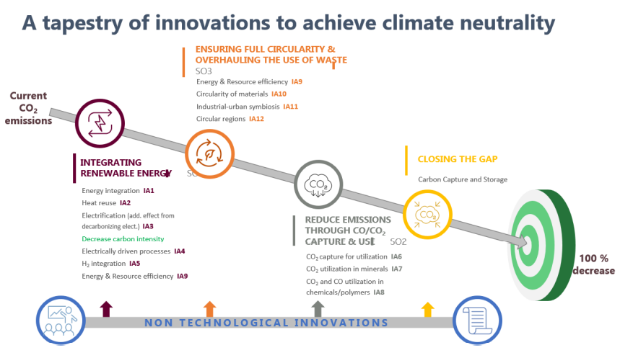
Context - Energy intensive industries: Why do they matter and what can innovation do?

Slide 10
Topic: Decarbonisation of Energy-Intensive Industries Expected Outcomes
Accelerate the use of innovative processes to decarbonise industrial processes and bring to the market more cost-effective clean products to strengthen the competitiveness (including biodiversity), and resilience of EU industries (with quantifiable contribution);
Create new innovative first-of-a-kind operational demonstrators and/or optimise newly installed industrial decarbonisation solutions in Europe; and
Demonstrate the market readiness of the envisaged future clean products and their innovative processes via a credible business plan and an exploitation strategy for industrialisation, including market-tested use cases.

Slide 11
Topic: Decarbonisation of Energy-Intensive Industries Scope
Three tech areas in EII with promising growth potential in Europe. Proposals are expected to address one or several of these areas:
Managing of carbon cycle (CCU/CCUS): optimize and demonstratie technologies for capturing, utilizing, or storing CO2 and CO from energy-intensive industries.
Clean energy usage in production: support major improvements of clean energy usage in the energy intensive industries.
Circularity and resource efficiency: improve resource efficiency (raw materials, energy, and water) across process industries, including the creation of circular value networks that utilize industrial side-streams and end-of-use waste.

Slide 12
European partnership Processes4Planet
Co-programmed, public-private partnership under Horizon Europe; successor of SPIRE partnership (H2020)
Partners
Process industry, represented by the A.SPIRE association
10 sectors: cement, ceramics, chemicals, engineering, minerals and ores, non-ferrous metals, steel, water, pulp & paper and refining
Strategic Research and Innovation Agenda: Website of A.SPIRE
p4planet_SRIA.pdf
p4planet_SRIA_update2024.pdf
Objectives
Processes4Planet aims to transform European process industries to make them circular and achieve overall climate neutrality at EU level by 2050, while enhancing their global competitiveness. Processes4Planet aims to achieve three general objectives:
Developing and deploying climate neutral solutions
Closing the energy and feedstock loops
Achieving a global leadership in climate neutral and circular solutions

Slide 13
European Clean Steel Partnership
Co-programmed, public-private partnership under Horizon Europe.
Partners
Public side: DG RTD and DG GROW.
Private side: steel industry, represented by the European Steel Technology Platform (ESTEP): ESTEP website
Strategic Research and Innovation Agenda:
Available from ESTEP’s website at: 2024-CSP-SRIA.pdf
Objectives
General objective: Develop technologies at TRL8 to reduce CO2 emissions stemming from EU steel production by 80-95% compared to 1990 levels.
Specific objectives:
Enabling steel production through carbon direct avoidance (CDA) technologies at a demonstration scale.
Fostering smart carbon usage (SCU – Carbon capture) technologies in steelmaking routes at a demonstration scale, thus cutting CO2 emissions from burning fossil fuels (e.g. coal) in the existing steel production routes.
Developing deployable technologies to improve energy and resource efficiency (SCU - Process Integration).
Increasing the recycling of steel scrap and residues, thus improving smart resources usage and further supporting a circular economy model in the EU.
Demonstrating clean steel breakthrough technologies contributing to climate-neutral steelmaking.
Strengthening the global competitiveness of the EU steel industry in line with the EU industrial strategy for steel.

Slide 14
Cleantech for Climate topic
14

Slide 15
Topic: Clean Tech for Climate Expected Outcomes
Strengthen the competitiveness, sustainability and resilience of an innovative clean tech solution by clearly demonstrating the capability to, significantly:
(1) increase its circular material use rate, based on a sound and realistic baseline;
(2) reduce the levelized cost of energy (LCOE) delivered to end-users - including, where relevant, production, distribution, and storage costs, based on a sound and realistic baseline and considering different geographic scenarios; and
(3) improve Europe’s industrial leadership, resilience, and supply chain security, in line with the objectives of Net-Zero Industry Act (NZIA) for the EU manufacturing capacity of net-zero technologies,.
Bring this innovative cleantech solution to full technological maturity and close to market-readiness with a view to accelerating its market deployment and/or integration in key industrial sectors in Europe (e.g. manufacturing, energy and transport).

Slide 16
Topic: Clean Tech for Climate Scope
Three clean tech areas with promising growth potential in Europe (based on the Transition Initiatives of the Clean Energy Transition (CET) Partnership). Proposals are expected to address one or several of these areas:
Integrated net-zero emissions energy systems (e.g. including energy grids, networks and systems)
Enhanced zero-emission power technologies (e.g. including renewable electricity, heat and energy technologies)
Storage technologies, renewable fuels, and carbon capture and utilisation (e.g. including batteries and other energy storage solutions, renewable hydrogen , advanced biofuels and synthetic renewable fuels) enabling climate neutrality

Slide 17
Specific requirements
17

Slide 18
Balanced Portfolios (For Each Topic)
Applicable separately to each of the two topics under the call:
Proposals should clearly select one main area but can also address in an integrated way a combination of the three areas under the respective scopes. Applicants are free to decide on the specific value chain they wish to strengthen in the above tech areas.
To contribute to a balanced portfolio covering the three tech areas described in the respective scopes, grants will be awarded to applications not only in order of ranking, but also at least to one (1) proposal that is the highest ranked for each main tech area, provided that the applications attain all thresholds.
Synergies:
Projects funded under these topics will be encouraged to develop synergies and coordinate with similar or complementary projects funded under the respective other topic in the call, as well as with relevant projects funded under relevant European Partnerships.

Slide 19
“Go/no go” moment
Critical milestone required by some topic texts in Horizon Europe, and included in the Clean Industrial Deal (CID) call.
Projects have to demonstrate that they comply with several requirements before entering the demonstration phase.
These conditions vary depending on the topic text. Always check the official work programme and adjust to the exact conditions of your topic.
Do not incur any costs related to the demonstration/deployment activities before obtaining a "go" decision from your granting authority.
In practice:
Help proposals to think ahead introducing credible, achievable milestone with all due requirements
It is important to take the “go/no go" milestone seriously from the proposal stage, avoiding to assume that any issues can be rectified during the grant preparation phase or the project itself.

Slide 20
Call Dates
20

Slide 21
Call Dates
Opening: 18 Dec 2025
Deadline: 15 Sep 2026
HORIZON-CID-2026-01-01: R&I in Support of the Clean Industrial Deal: Decarbonisation of energy intensive industries
HORIZON-CID-2026-01-02: R&I in Support of the Clean Industrial Deal: Clean Technologies for Climate Action
Opening: 12 Jan 2027
Deadline: 15 Sep 2027
HORIZON-CID-2027-01-01: R&I in Support of the Clean Industrial Deal: Decarbonisation of energy intensive industries
HORIZON-CID-2027-01-02: R&I in Support of the Clean Industrial Deal: Clean Technologies for Climate Action

